Slide 1

Spaceship Titanic
Made by: Elizaryev Makar & Mikhalev Dima

Slide 2
Description
The Spaceship Titanic was an interstellar passenger liner launched a month ago. With almost 13,000 passengers on board, the vessel set out on its maiden voyage transporting emigrants from our solar system to three newly habitable exoplanets orbiting nearby stars.
While rounding Alpha Centauri en route to its first destination—the torrid 55 Cancri E—the unwary Spaceship Titanic collided with a spacetime anomaly hidden within a dust cloud. Sadly, it met a similar fate as its namesake from 1000 years before. Though the ship stayed intact, almost half of the passengers were transported to an alternate dimension!
Task: predict which passengers were transported by the anomaly

Slide 3
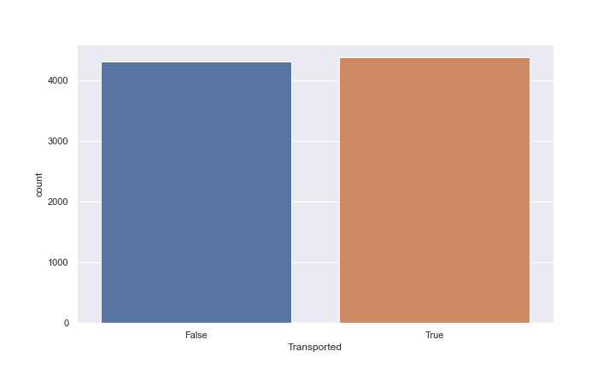
EDA
Target
train.csv 8693
test.csv 4277 :
- 13 features (float64(6), object(7)
- 2324 NaN)
- Target: 'Transported' (binary)

Slide 4
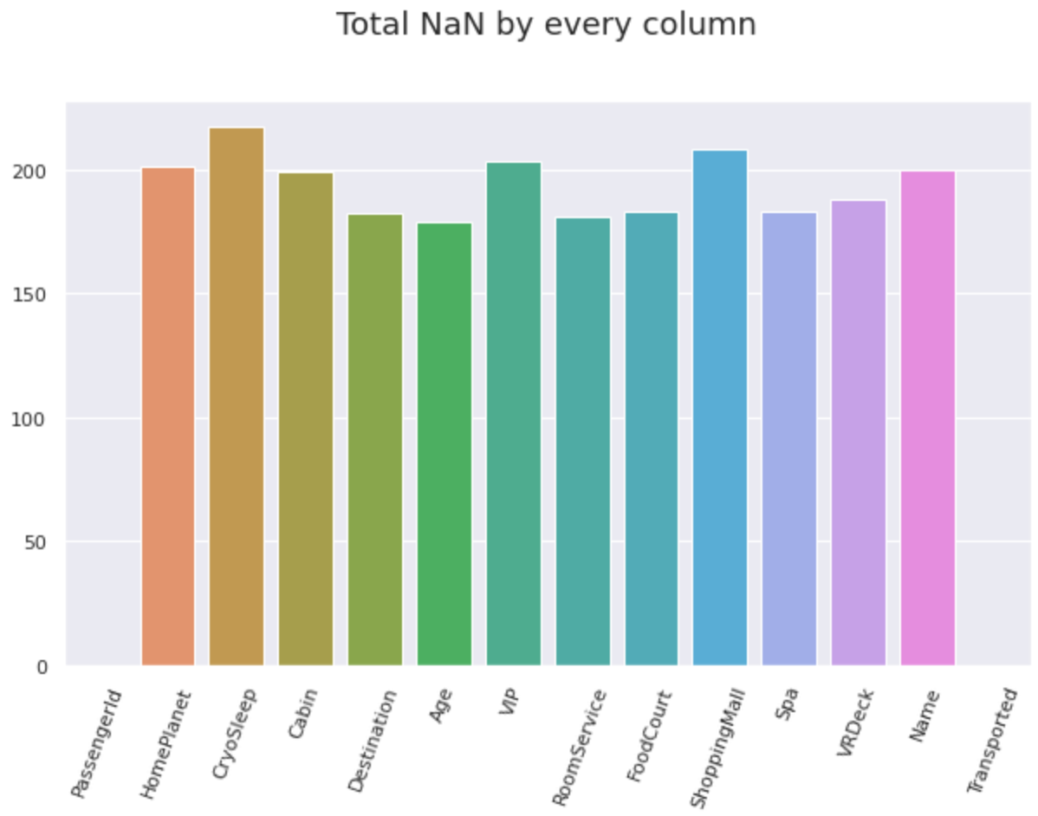

Slide 5
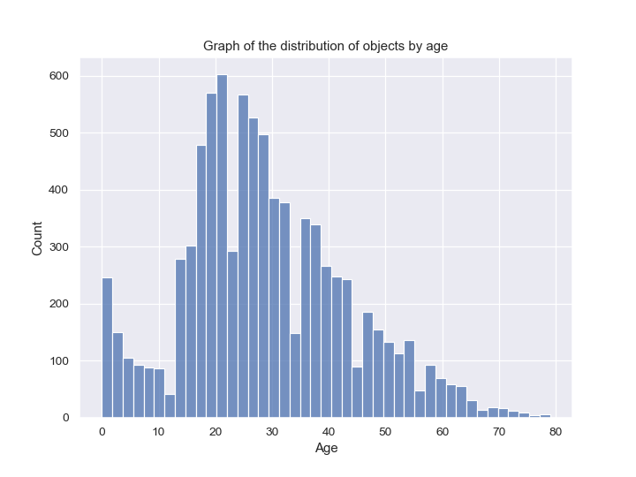

Slide 6
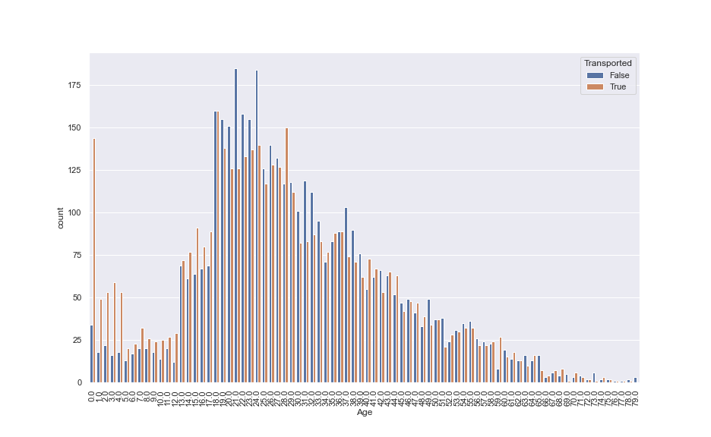
People < 18 years tend to be transported

Slide 7
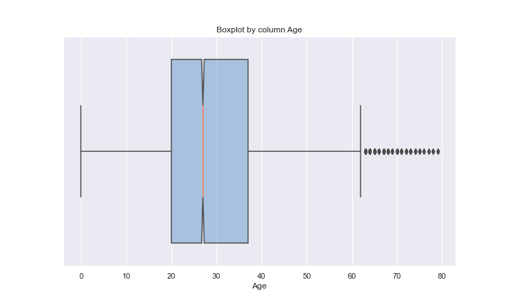

Slide 8
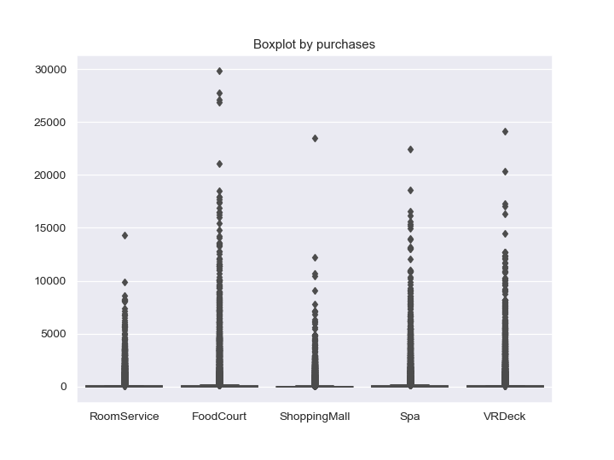

Slide 9
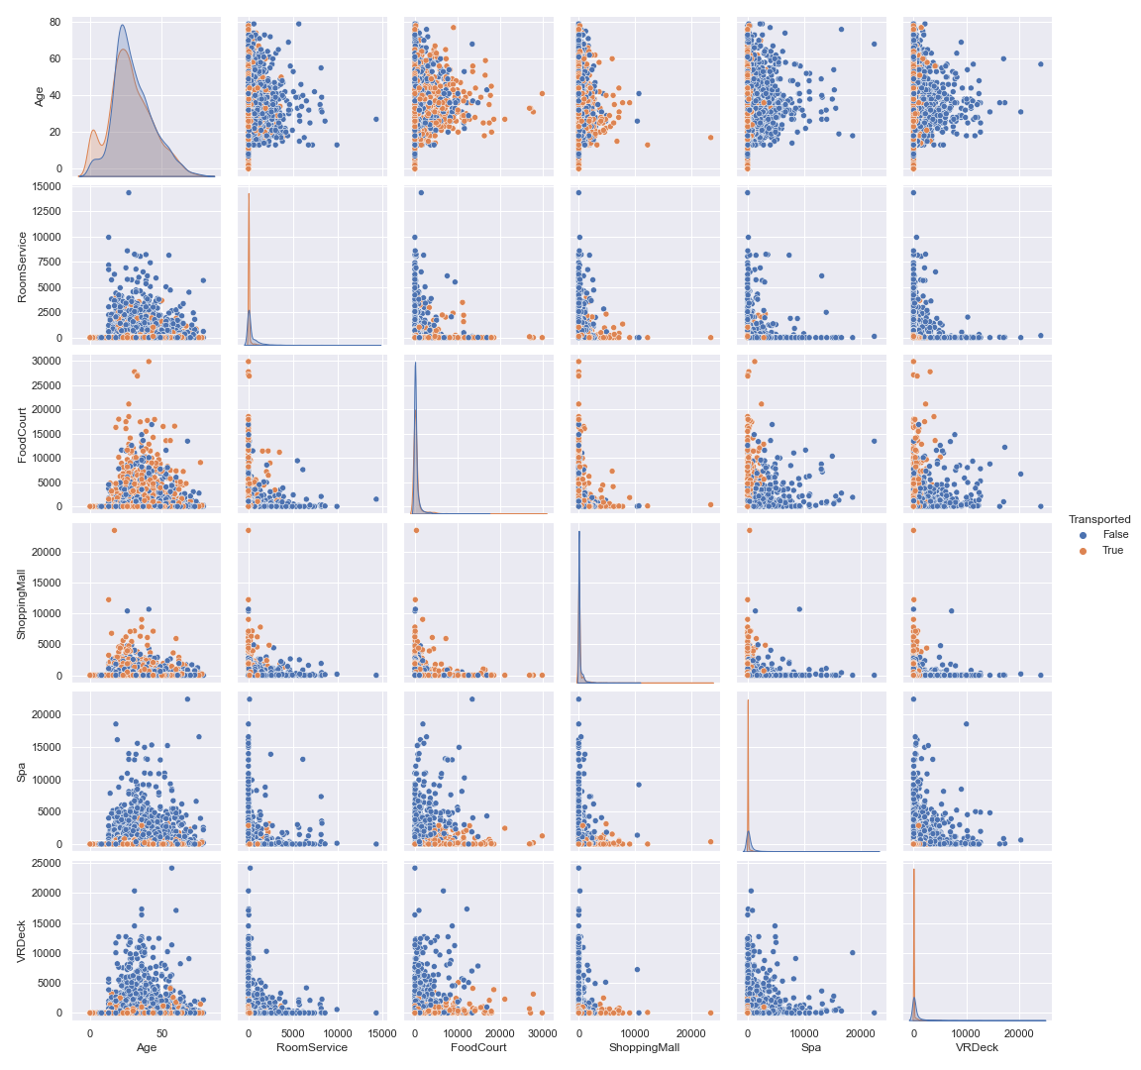
Transported people tend to have less bill on Spa, VRDeck & RoomService than the non transported people
-Transported people tend to have more bill on FoodCourt & ShoppingMall than the non transported people

Slide 10
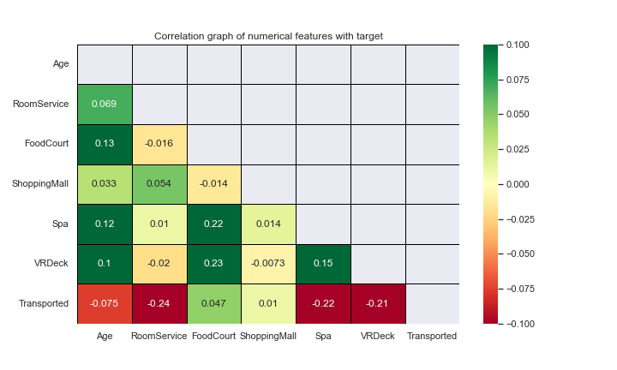

Slide 11
Feature engineering
Split 'Cabin' (deck/num/side) feature. Get 'deck' and 'side' information.
Extracted the first number in 'PassengerId' and the surname from 'Name', then they was concatenated as new column. Repetitions were searched for on a new feature. The results were written in 'RepeatedBySurname&PassIdFirstNum'.

Slide 12
Filling NaN
Filling NaN on object type columns by mode
If you are sleeping, then it is logical that you cannot buy something, so you should fill in zeros for all NaN on purchases for those who are sleeping. But we still have a median for all purchases equal to zero, which makes it easier for us to fill in the features.
For purchases, it is fair to take the median, since there are a lot of those who did not make a purchase at all, which means that if we calculate by the average, then we will distort the trend in the data.
Fill in the numerical features with a median that is equal to zero. Without 'Age'
And fill in 'Age' by mean and round it

Slide 13
Augmentation
# Purchases
'TotalPaid' = 'RoomService' + 'ShoppingMall' + 'Spa' + 'FoodCourt' +'VRDeck'
'HasPaid' = 'TotalPaid' > 0
'HasPaidRoomService' = 'RoomService' > 0
'HasPaidFoodCourt' = 'FoodCourt' > 0
'HasPaidShoppingMall' = 'ShoppingMall' > 0
'HasPaidSpa' = 'Spa' > 0
'HasPaidVRDeck' = VRDeck' > 0
# Age
'IsAdult' = 'Age' >= 18
'IsEmbryo' = 'Age' == 0

Slide 14

Model selection
- Fast learning speed and high efficiency
- Lower memory usage
- Better accuracy than any other amplification algorithm
- Compatibility with large datasets

Slide 15
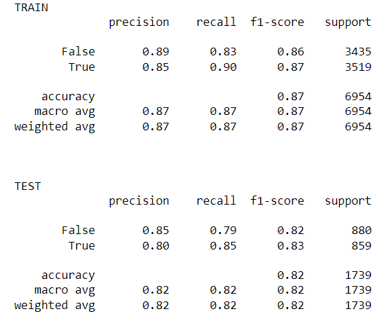
Result by random_state = 18
Best score f1: 0.8063459064466605
Best parameters: {'max_depth': 15, 'lr': 0.1}

Slide 16
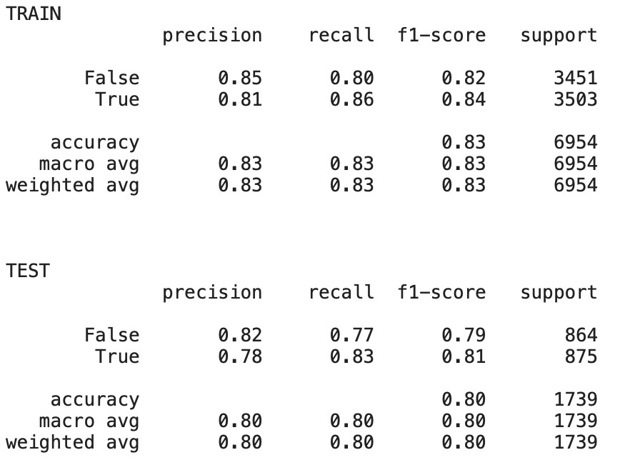
Result by random_state = 14
Best score f1: 0.8139124620029801
Best parameters: {'max_depth’: 4, 'lr': 0.75}

Slide 17
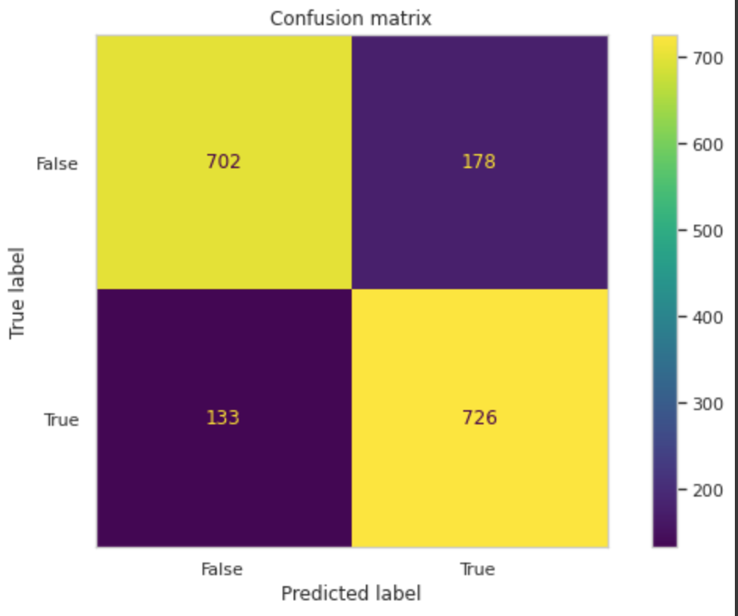
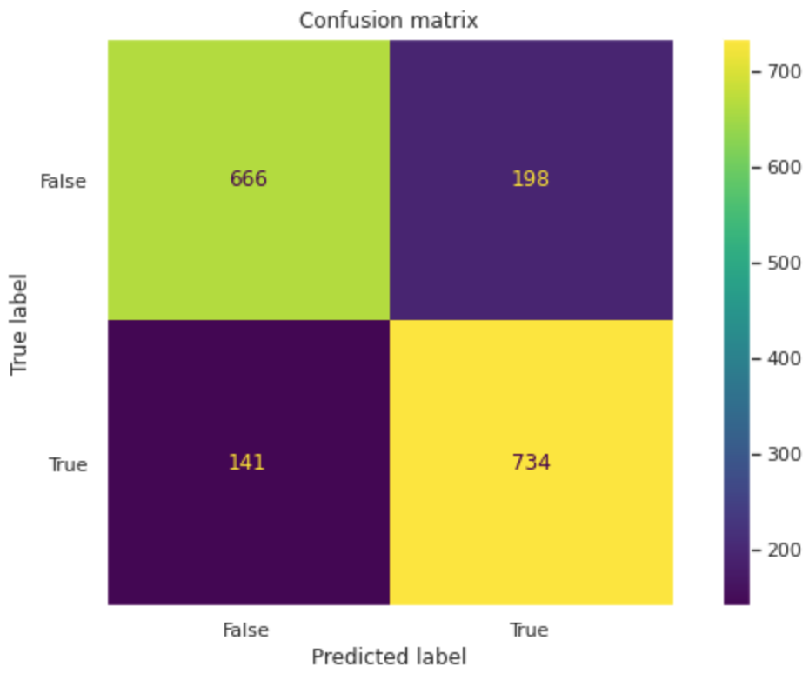
Compare both results
random_state = 18
random_state = 14

Slide 18
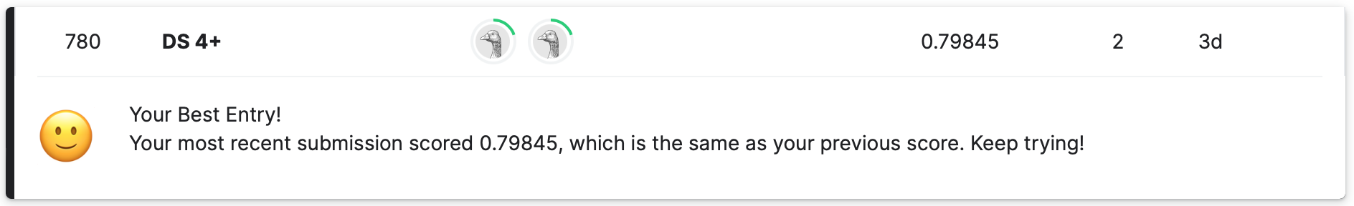
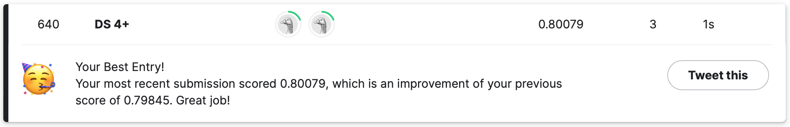
Submission: 18 vs 14

Slide 19
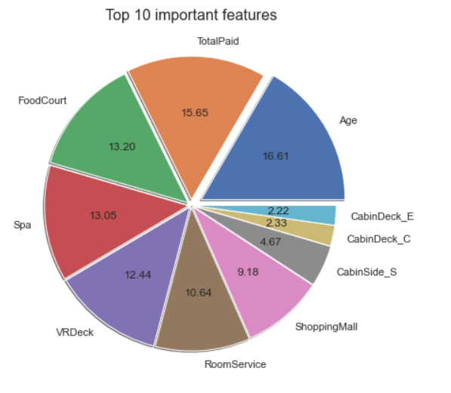
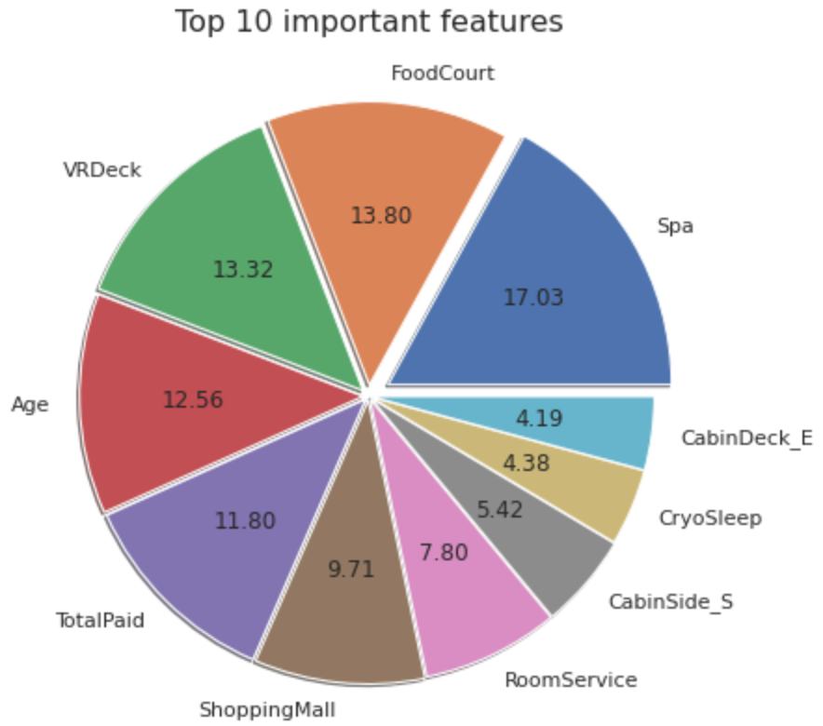
Feature importance
random_state = 18
random_state = 14

Slide 20
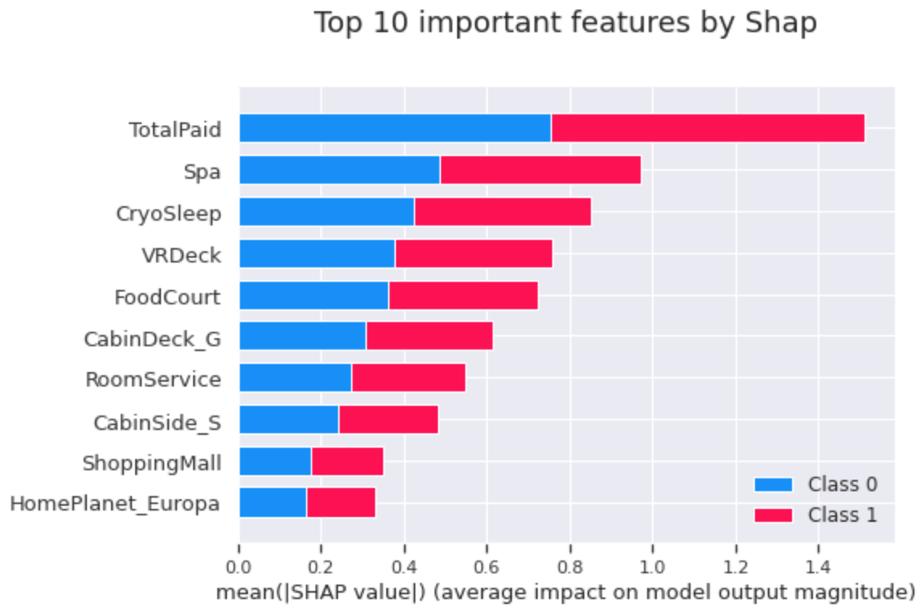

Slide 21
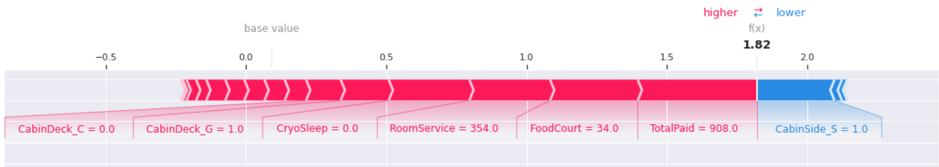
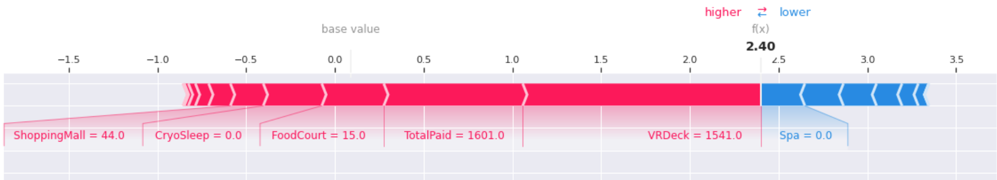
First object
14-th object

Slide 22
Thank you for attention!

